Slide 1
Project Title: ART HUB-online Art gallery
GUIDE:Dr Manju S.Nair NAME:Abhishek kp
ROLL NO:03

Slide 2
INTRODUCTION
Empower Artists: Offer a digital canvas for emerging and established artists to exhibit their creations, encouraging artistic growth and exposure...
Connect Communities: Facilitate connections between artists and art enthusiasts, fostering a supportive community where ideas, inspirations, and critiques can be shared seamlessly..
Enhance Accessibility: Break down geographical barriers by providing a platform that enables users from around the world to engage with art, thus democratizing the art-viewing experience.
Curate Diversity: Showcase a wide array of artistic styles, mediums, and genres, ensuring that the online gallery becomes a melting pot of creativity, promoting inclusivity in the art world.
Streamline Transactions: Enable secure online transactions, allowing collectors to purchase artworks directly from the platform, thereby supporting artists economically.

Slide 3
PROBLEM STATEMENT
The current limitations of traditional art galleries, constrained by physical space and geographical boundaries, hinder artists' exposure and restrict art enthusiasts' access. The Online Art Gallery aims to address these challenges by creating a virtual platform that transcends these limitations, fostering a global community of artists and art lovers..

Slide 4
EXISTING SYSTEM
Physical Art Galleries:
Location-Based: Traditional art galleries are physical spaces located in specific geographic areas.
Limited Capacity: These galleries have finite space, restricting the number of artworks that can be displayed at any given time.
Geographical Constraints:
Local Exposure: Artists primarily gain exposure within their local communities or regions through physical galleries.
Global Limitations:their work may not be easily accessible to international audience.
Limited Rotations: Due to space constraints, only a portion of an artist's portfolio may be displayed at a given time.
Transaction Processes:
Offline Transactions: .
Limited Accessibility: Potential buyers need to visit the physical location to make a purchase.

Slide 5
PROPOSED SYSTEM
Virtual Art Gallery:
Digital Space:involves a virtual platform accessible worldwide, eliminating the constraints of physical space.
Unlimited Capacity: can accommodate a vast and diverse range of artworks.
Global Reach:
International Exposure: reaching audiences beyond their local or regional boundaries.
Increased Accessibility: anywhere in the world can explore and engage with artworks online.
Dynamic Showcasing: regularly update and showcase their entire portfolio.
E-commerce Integration:
Online Transactions: Implementing a secure online payment system.
Global Sales: Buyers can make purchases from anywhere, promoting international transactions.

Slide 6
MODULES
User Authentication and Authorization:
Description: Handles user registration, login, and account management functionalities.
Functionality: Securely manages user profiles, allowing artists and visitors to have personalized experiences.
Artist Profile Management:
Description: Enables artists to create and manage their profiles, including portfolio uploads, biographies, and other relevant information.
Functionality: Supports the customization of individual artist spaces within the online gallery.
Artwork Catalog and Management:
Description: Allows artists to upload, organize, and manage their artworks.
Functionality: Includes features for adding titles, descriptions, dimensions, and other relevant details. Supports versioning for updates.
Search and Filter Functionality:
Description: Enables users to search for specific artworks or artists and apply filters to refine their searches.
Functionality: Incorporates search algorithms, filters by categories, styles, and other criteria.

Slide 7
Admin Panel:
Description: Provides a backend interface for administrators to manage users, artworks, exhibitions, and overall site configuration.
Functionality: Includes tools for content moderation, user management, and system configuration.

Slide 8
Front End: Html, CSS, and JavaScript
Back End: PHP
Database: Mysql

Slide 9
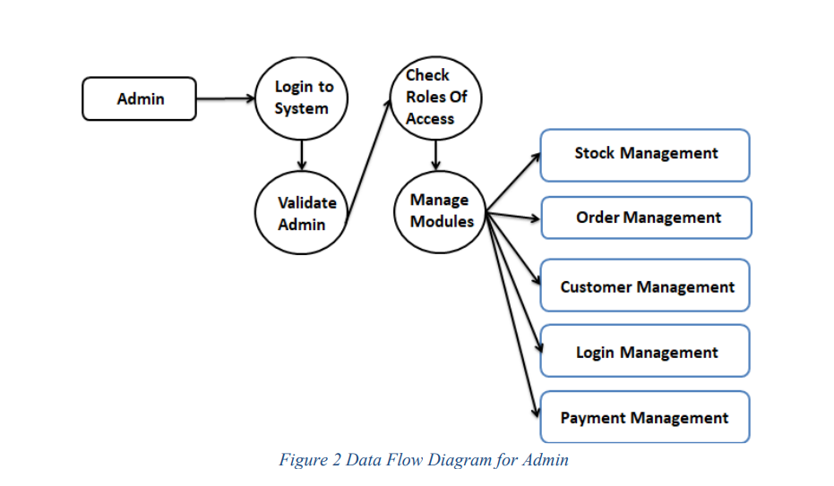
Data Flow Diagram
Level 0

Slide 10
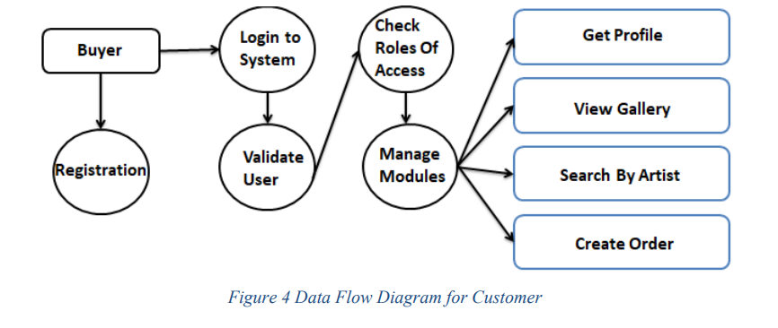
Level 1

Slide 11
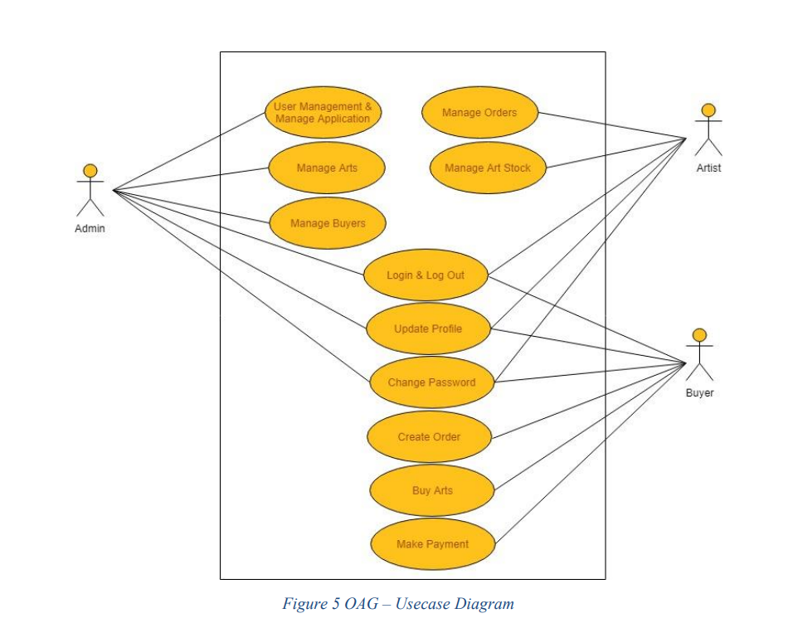
Level 2

Slide 12
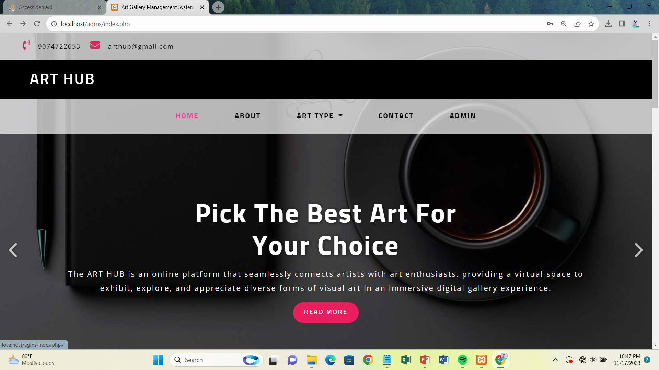
SCREENSHOTS

Slide 13
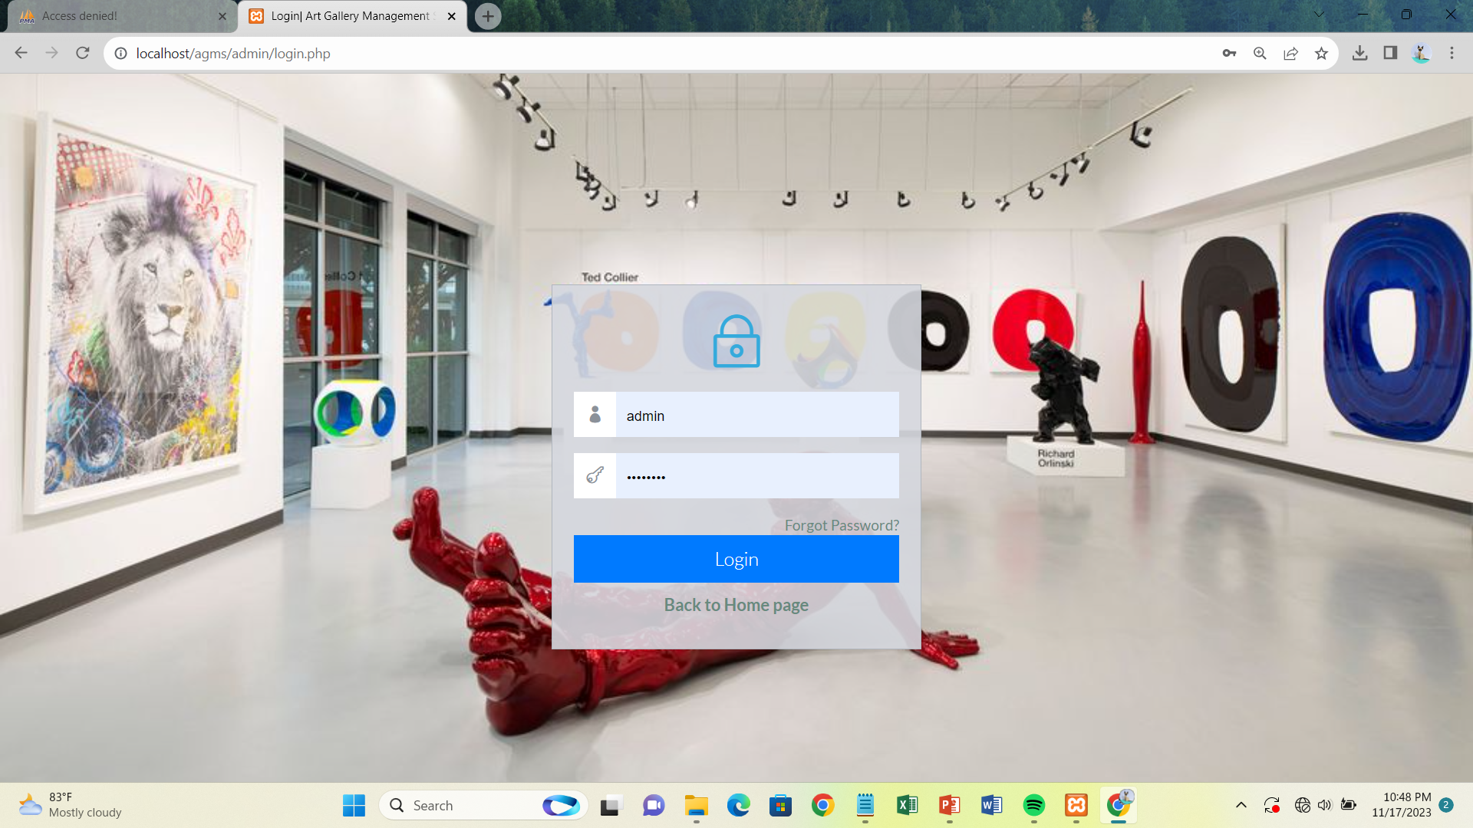

Slide 14
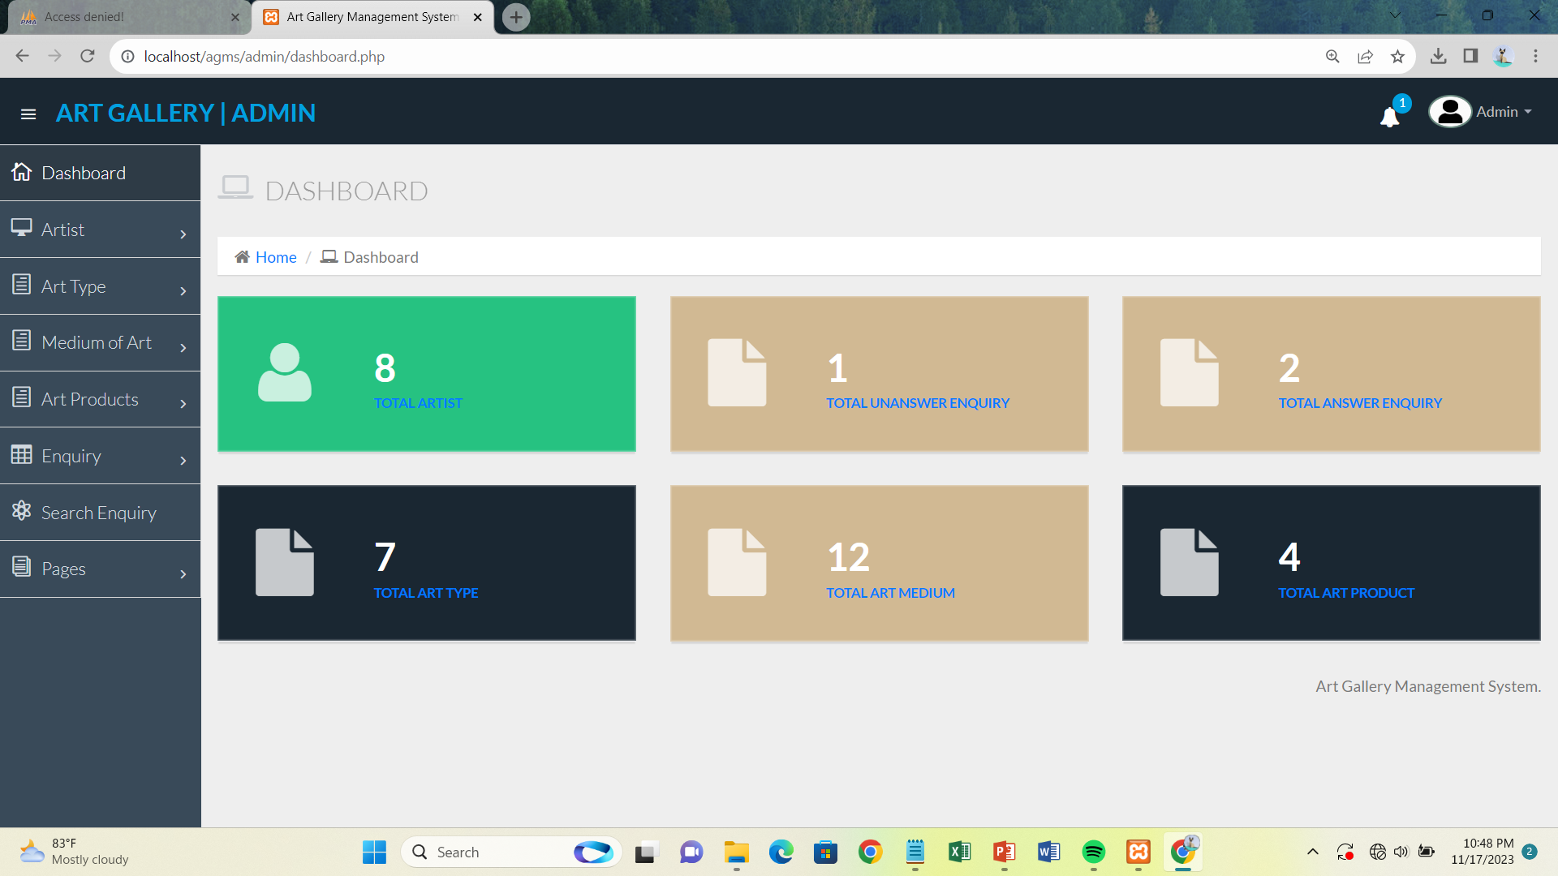

Slide 15
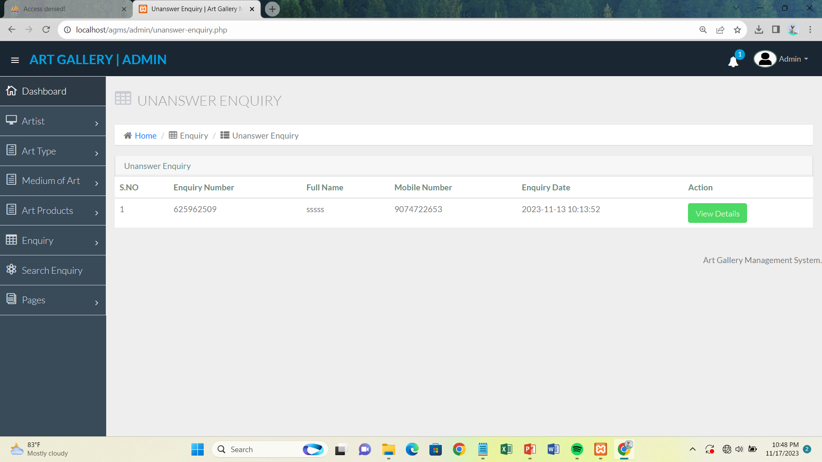

Slide 16
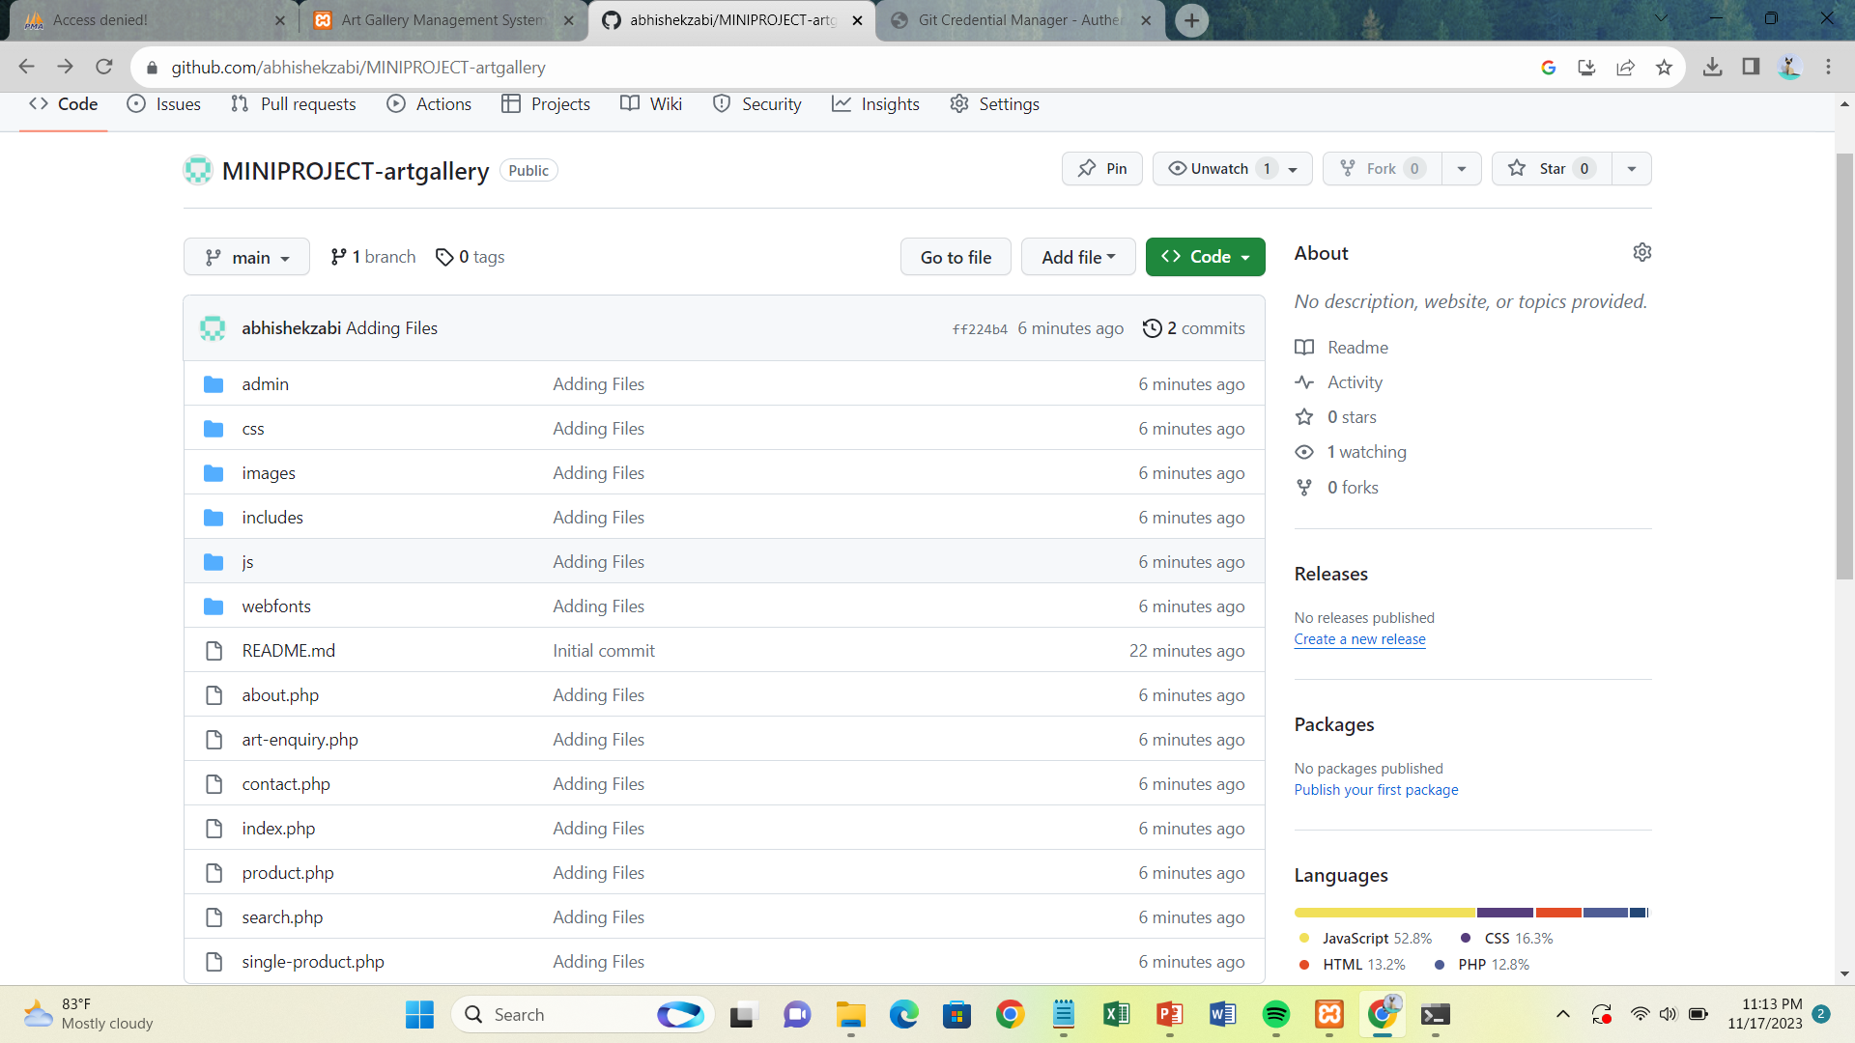

Slide 17
CONCLUSION
the [Online Art Gallery Project] has not only successfully bridged the gap between art and technology but has also created a vibrant digital ecosystem for artists and art enthusiasts. The journey, marked by technical innovations, diverse artistic expressions, and community engagement, has been both enriching and challenging. As we reflect on the accomplishments and lessons learned, we are reminded that the intersection of creativity and virtual platforms offers limitless possibilities. The success of this project is not merely measured in code and pixels but in the connections forged, the cultures celebrated, and the inspiring works of art shared. Looking forward, we remain committed to the continuous evolution of this online art gallery, exploring new horizons and ensuring that the world of art remains accessible, inclusive, and ever-inspiring for all.

